Slide 1
LOAN APP AS A SERVICE

Slide 2
SUMMARY
POC demonstration of a loans application as microservices.

Slide 3
PROBLEM STATEMENT
Design an API as a microservice to allow a user to achieve the below :-
1. Request for a customer loan status using a unique ID and get a response if the customer has/has no active loan.
2. Request for customer loan information and receive a list of all loans taken in the last 3 months. Think of this as a mini statement.
3. Request for a customer credit score status and return a status “Good” or “Bad”
4. Build a simple progressive web app to consume the above service exposing the 3 functions to a user.

Slide 4
TECHNOLOGIES USED
Springboot for Java Microservices.
Node.js, Express for fronted PWA.
Azure SQL Database.
Azure Container Registry
Sonarqube

Slide 5
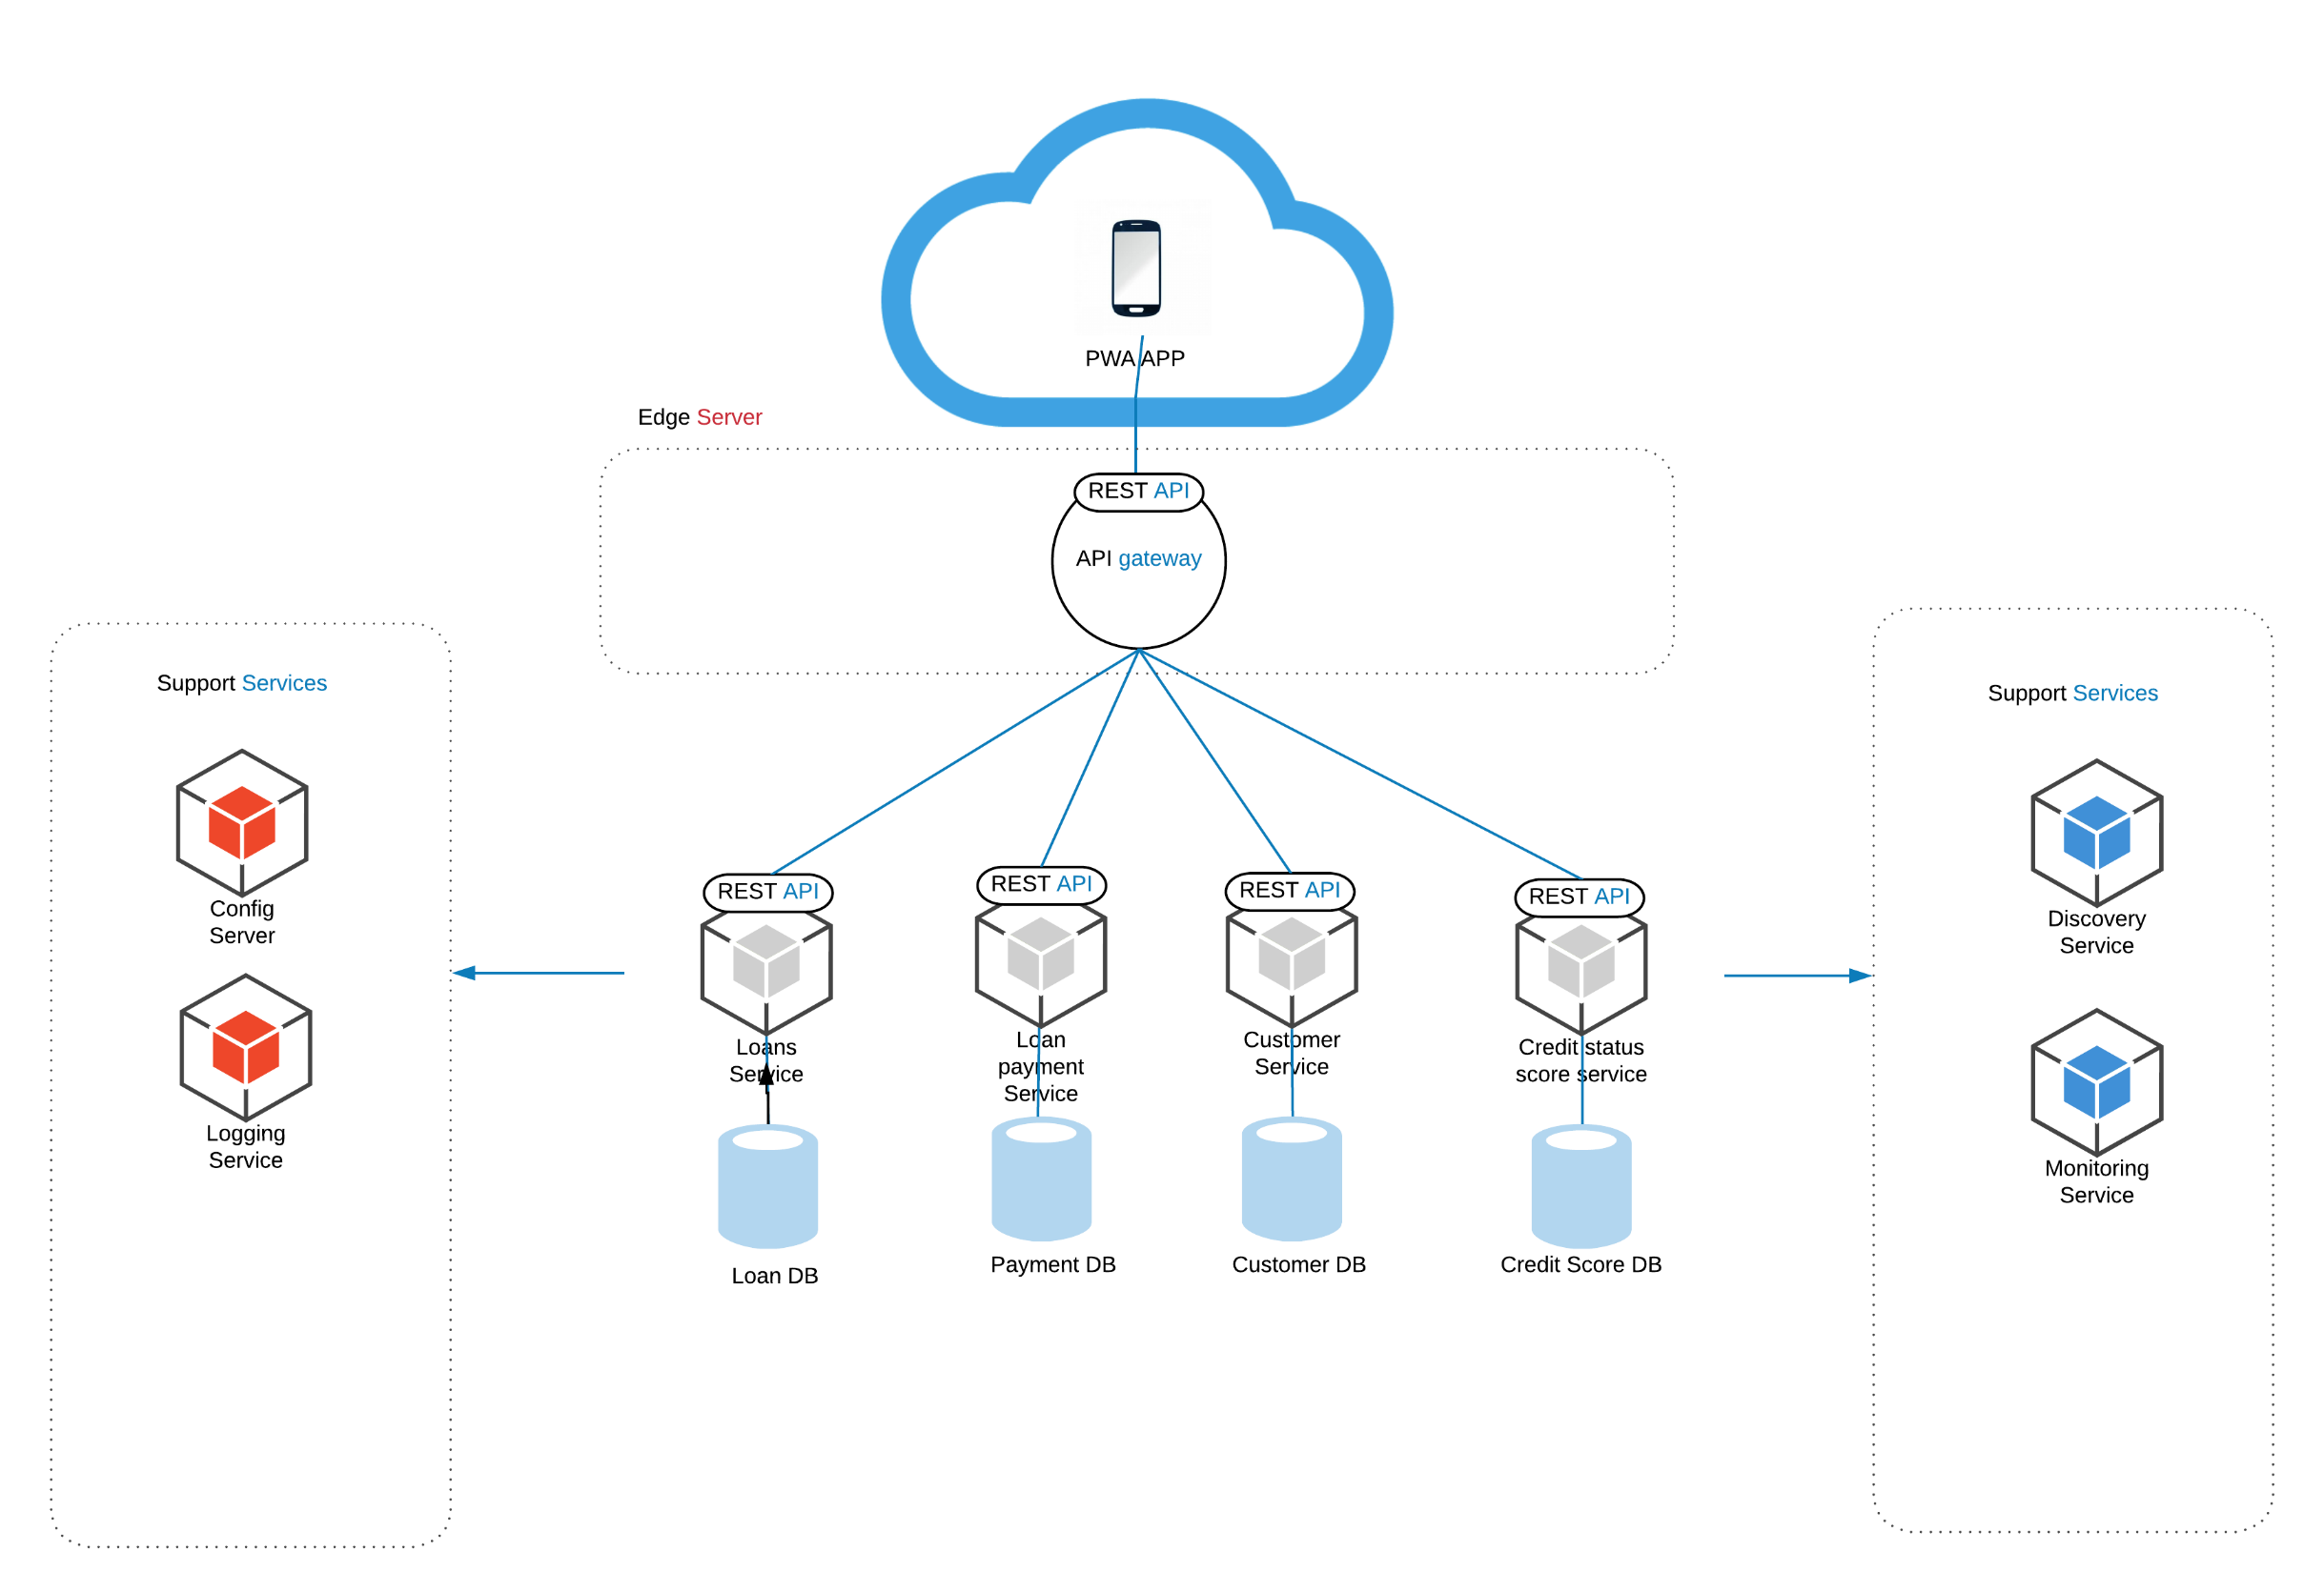
SOLUTION ARCHITECTURE

Slide 6
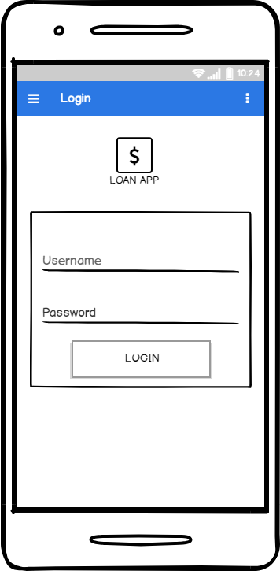
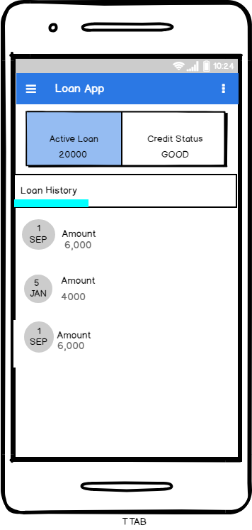
UI MOCKUP

Slide 7
Thank You

